Slide 1
Over the summer

Slide 2
Data
Transect data up to 2016 (missing Baja, today)
Surveys from 5 communities (1 more next week)

Slide 3
Preliminary analysis of QRoo
3 communities (8 reserves)
Only ecological indicators
Multiple Linear Regression
“Score cards”
Parametrized report (one line to analyze)
MPAreport_html(fish, invert, community, reserve, control)
jcvdav.github.io/QRoo

Slide 4
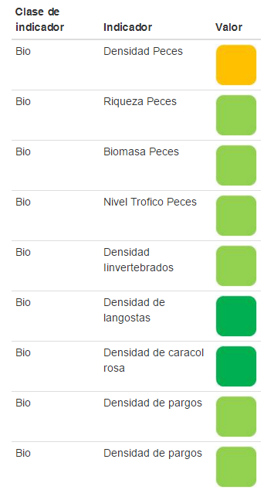

Slide 5
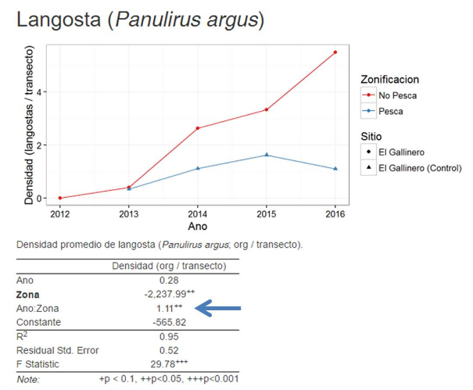

Slide 6
NIPARAJÁ
Presented the QRoo case study to the NGO
Interested in our framework
COBI interested in us using NIPARAJÁ’s data as GoC pilot
More data
Need to renew

Slide 7
Renewing ZRP
NOM 049 outlines how to ESTABLISH a ZRP
ZRP can be:
Temporal / Permanent
Total / Partial
NOM 049 does not include how to:
Monitor a ZRP(protocol)
Evaluate a ZRP (TURFeffect)
Re-establish them (if they are temporal)

Slide 8
Meeting with INAPESCA
List of indicators
Framework
Preliminary results for Sian Kan (QRoo)

